Slide 1


Santhosh Kumar
23.11.2021

Slide 2

Outline
Executive Summary
Introduction
Methodology
Results
Conclusion
Appendix

Slide 3
Executive Summary
Summary of methodologies
Data collection (used rest API and web scrapping)
Data wrangling
Explorative data analysis with graphical visualisations
Interactive visual representation including a dashboard
Predictive modelling
Summary of all results
The data was pre-processed keeping the underlying information
The data was subsequently analysed with statistical and visual ways using open source tools (like plotly ans Dash)
A classification model was developed
Presenting the results to team members

Slide 4
Introduction
Background
Falcon 9 developed by space X is one of its kind because it was developed for its reuse. With reuse of the falcon 9 vehicle, dramatically reduces the cost of space exploration. This has to be inline with safety. Falcon 9 should be a reliable and safe transportation method for people and payloads.
Business problem definition
To come up with a predictive model for probability of successful landing of Falcon 9 using the given technical data regarding the rocket. This information will be used to estimate overall cost of the business if the success rate is identified.

Slide 5


Slide 6
Methodology
Executive Summary
Data collection methodology:
The data was collected with SpaceX rest API as well as web scrapping from Wikipedia
Perform data wrangling
Transforming the data with python libraries (feature extraction)
Creation of more and useful data (as columns) which are correlated with the outcome
Perform exploratory data analysis (EDA) using visualization and SQL
Perform interactive visual analytics using Folium and Plotly Dash
Perform predictive analysis using classification models
A classification model was build and tested with validation and test data

Slide 7
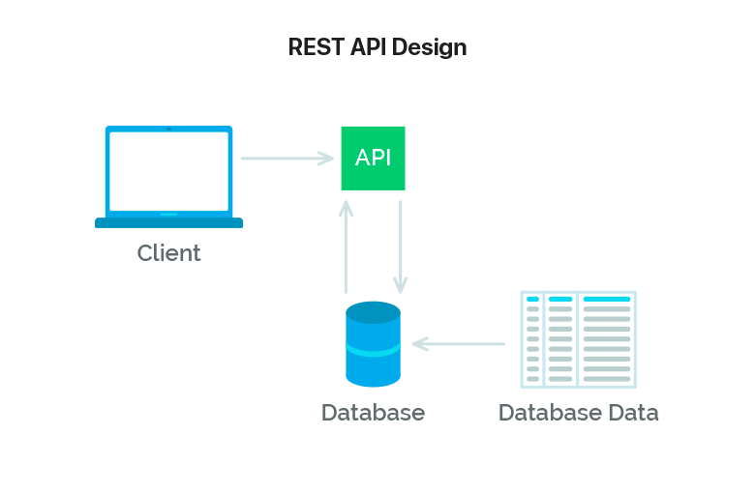
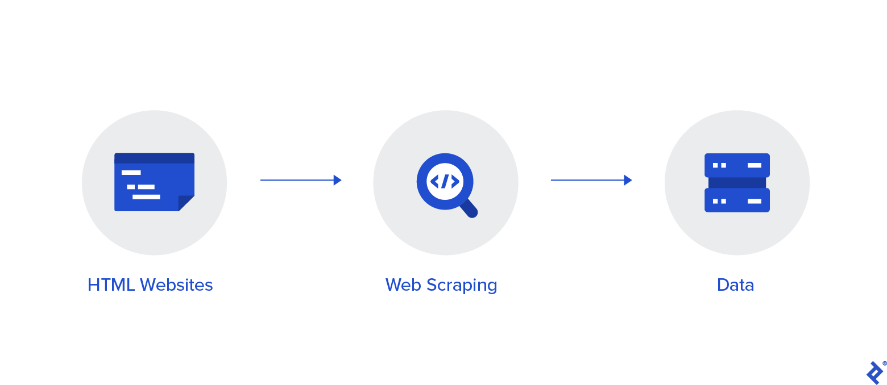
Data Collection
SpaceX has its own RESTAPI which can be accessed without any credentials. The project used this tool.
Web scraping is another useful tool which was used in this project.

Slide 8
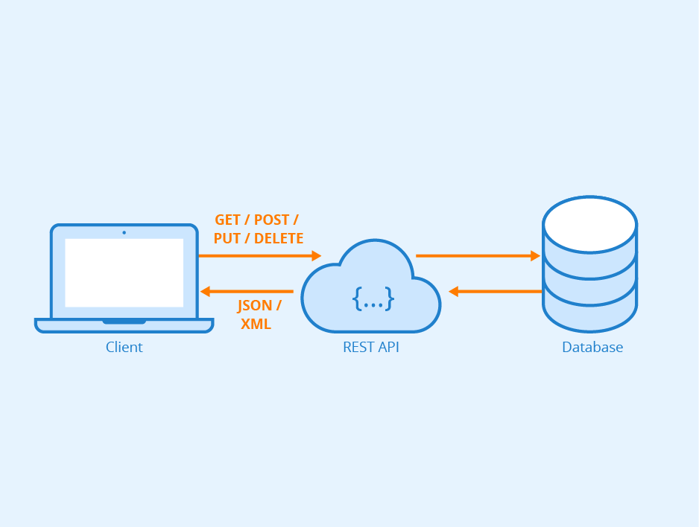
Data Collection – SpaceX API
Rest API presents json data which was fed into a dataframe
The API data obtained and the calls can be reviewed here
https://github.com/gvsanthu10/IBM_datascience/blob/main/Data%20Collection%20API%20Lab.ipynb

Slide 9
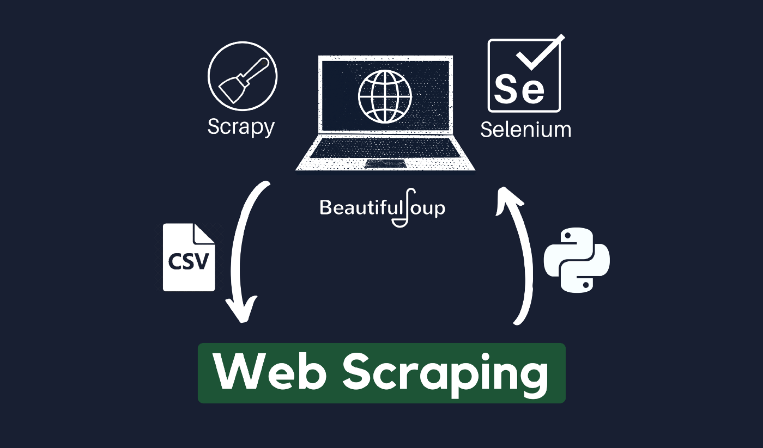
Data Collection - Scraping
With use of python libraries like requests, and beautifulsoup, additional data about falcon 9 was collected form Wikipedia
The python code obtained and the data processing can be reviewed here
https://github.com/gvsanthu10/IBM_datascience/blob/main/Data%20Collection%20with%20Web%20Scraping%20lab.ipynb

Slide 10
Data Wrangling
The collected data was preprocessed. The methods involved were replacing missing values, feature extraction and addition of new columns
The code of the data wrangling can be viewed here:
https://github.com/gvsanthu10/IBM_datascience/blob/main/Data%20Wrangling%20Lab.ipynb

Slide 11
EDA with Data Visualization
Several charts were plotted and the explained with inferences. The visual representation of the data was more initiative in explain few findings as well as finding important features
The code for the EDA with visualization can be viewed here:
https://github.com/gvsanthu10/IBM_datascience/blob/main/The%20EDA%20with%20Visualization%20lab.ipynb

Slide 12
EDA with SQL
SQL was used to obtain important values. SQL was used because of simplistic approach to access the data stored in a database
The source code is stored and accessed here:
https://github.com/gvsanthu10/IBM_datascience/blob/main/EDA%20with%20SQL%20lab.ipynb

Slide 13
Build an Interactive Map with Folium
An interactive map with Folium was developed to help understanding the data with graphs and maps. The map shows circular marks for each site with color coding depending on the outcome
The code for the folium map is found here:
https://github.com/gvsanthu10/IBM_datascience/blob/main/Interactive%20Visual%20Analytics%20with%20Folium%20lab.ipynb

Slide 14
Build a Dashboard with Plotly Dash
Another web based interactive dashboard was developed. This helped with sharing insights with the team members. Various types of the graphs shows relationship between different parametes(especially payload) with the outcome
The source code of the dashboard can be viewed here:
https://github.com/gvsanthu10/IBM_datascience/blob/main/spacex_dash_app.py

Slide 15
Predictive Analysis (Classification)
Several classification model were developed and their performance on the validation data was compared. GridSearchCV was a handy tool for the quick selection of optimal hyperparameters.
The source code can be viewed here:
https://github.com/gvsanthu10/IBM_datascience/blob/main/Machine%20Learning%20Prediction%20lab.ipynb

Slide 16
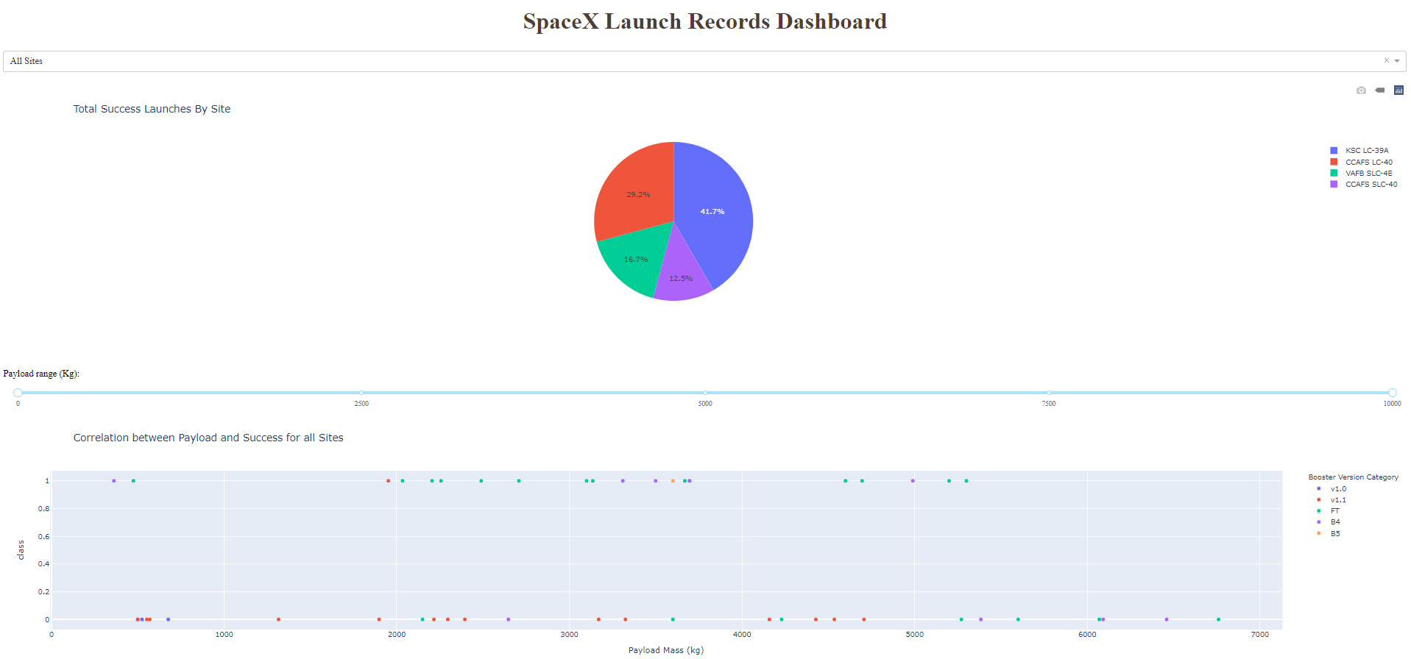
Results
EDA showed that orbit, launch site, payload and the number of flight were significantly correlated with the outcome
The highest accuracy of the models were 83%

Slide 17


Slide 18
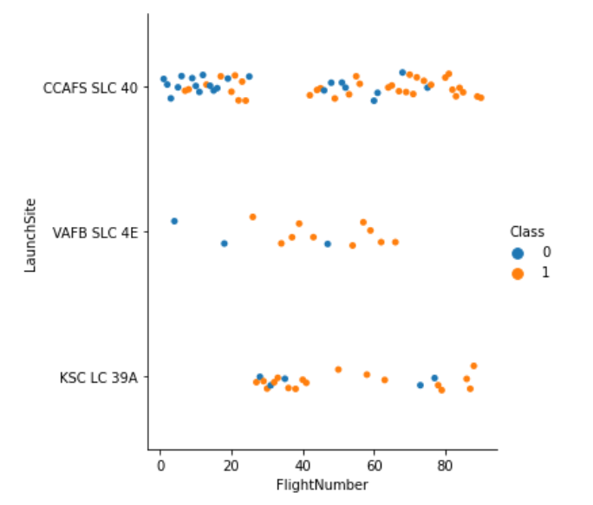
Flight Number vs. Launch Site
The chart shows increased success rate with increased number of flights
There is weak correlation with Launch site and outcome

Slide 19
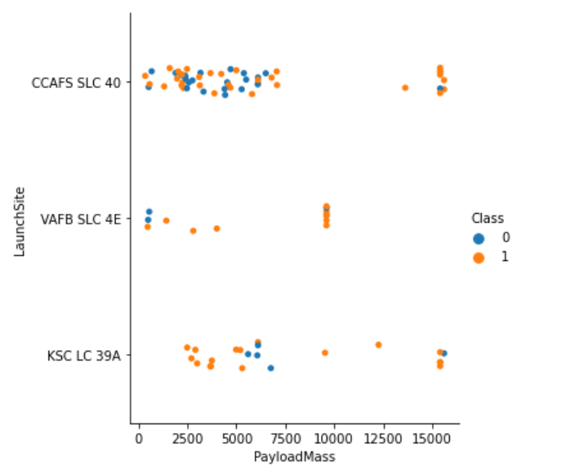
Payload vs. Launch Site
The graph shows a slight correlation of payload with the outcome

Slide 20
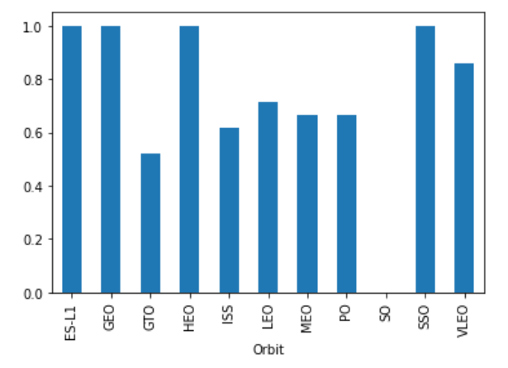
Success Rate vs. Orbit Type
Bar chart visualization of the Orbit type and the success rate. Few of the orbits are associated with less success rate

Slide 21
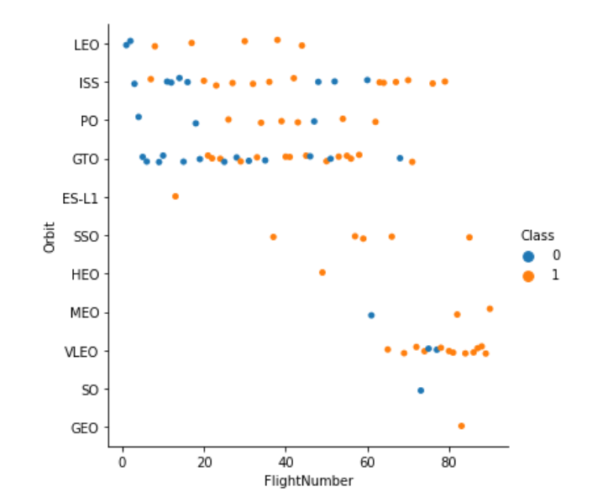
Flight Number vs. Orbit Type
This graph again shows increased success rate with increased flight number. The VLEO has good success rate partly due to increased flight number

Slide 22
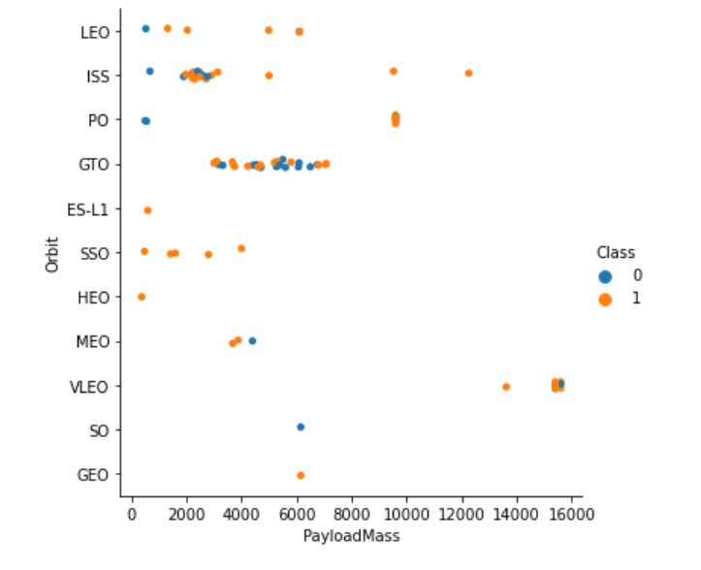
Payload vs. Orbit Type
Scatter plot with orbit and payload mass. There is a correlation of heavy payload with lower success rate

Slide 23
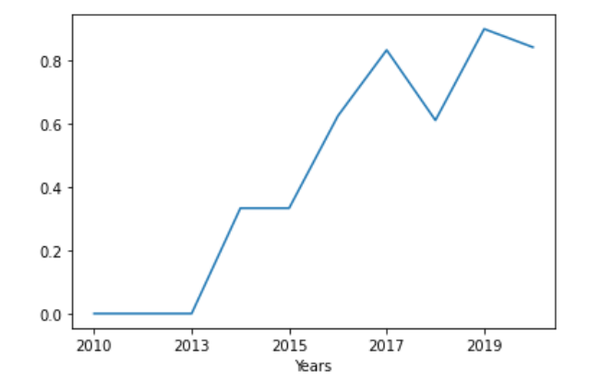
Launch Success Yearly Trend
A line chart showing progressive increase in the success rate vs time (years)

Slide 24
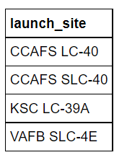
All Launch Site Names
These are our launch sites

Slide 25
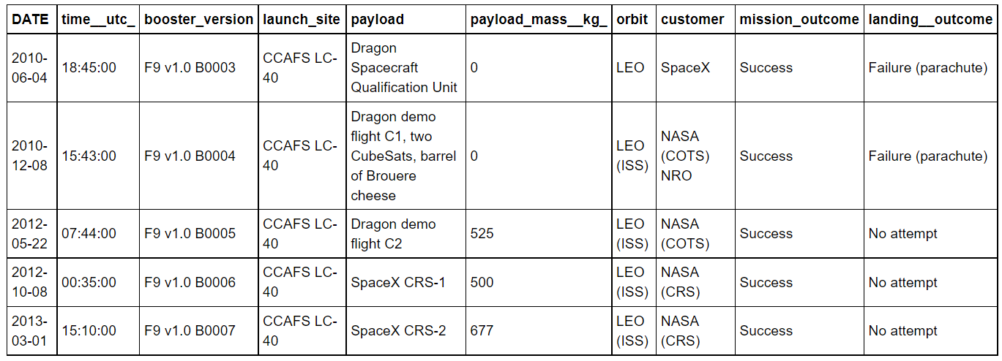
Launch Site Names Begin with 'CCA'
Result of query regarding launch site “CCA”
First 5 rows are shown here

Slide 26
Total Payload Mass
The total payload carried was 45596 kg. This might be an important figure which can be asked while estimating cost and profitability

Slide 27
Average Payload Mass by F9 v1.1
The average payload mass carried by F9 v1.1: 2534 kg. The new version has improve payload carrying capacity

Slide 28
First Successful Ground Landing Date
The dates of the first successful landing outcome on ground pad was 2015-12-22.

Slide 29
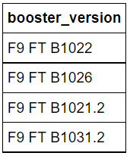
Successful Drone Ship Landing with Payload between 4000 and 6000
These are the list of booster versions with payload between 4000 and 6000

Slide 30
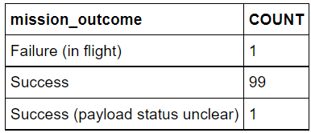
Total Number of Successful and Failure Mission Outcomes
The total count of success and failure of the mission show here

Slide 31
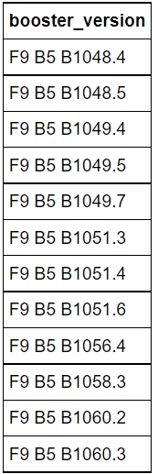
Boosters Carried Maximum Payload
These are the names of the boosters carried with maximum payload mass

Slide 32
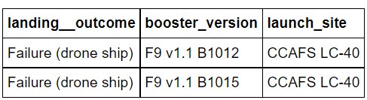
2015 Launch Records
This table (SQL output) shows failed landing outcomes for booster versions and launch site for year 2015

Slide 33
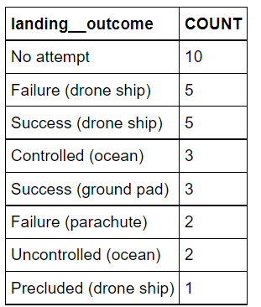
Rank Landing Outcomes Between 2010-06-04 and 2017-03-20
The total count of landing outcomes in for dates between 2010-06-04 and 2017-03-20

Slide 34


Slide 35
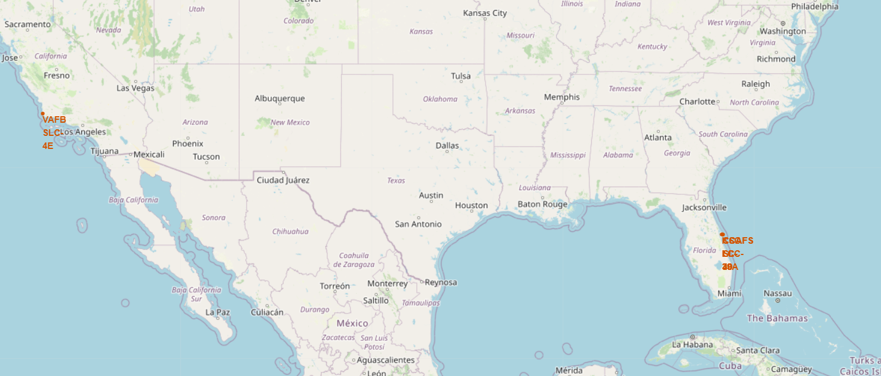
Lauch sites
This map with Folium showing all the lauch sites

Slide 36
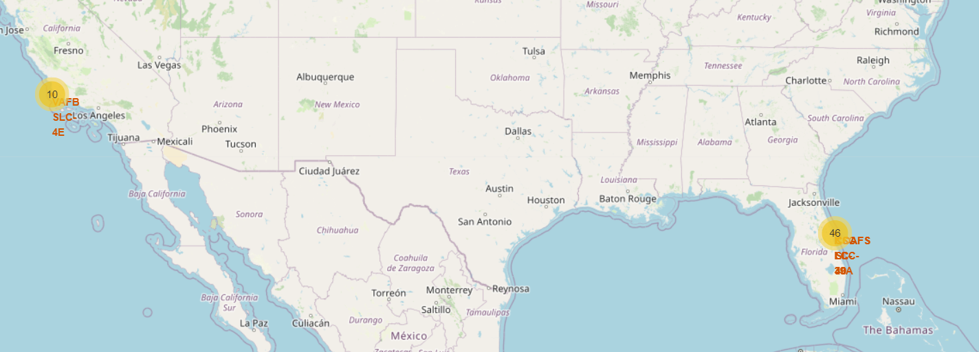
Map Overled with number of lauchs
46 launches were made east cost and 10 in west coast

Slide 37
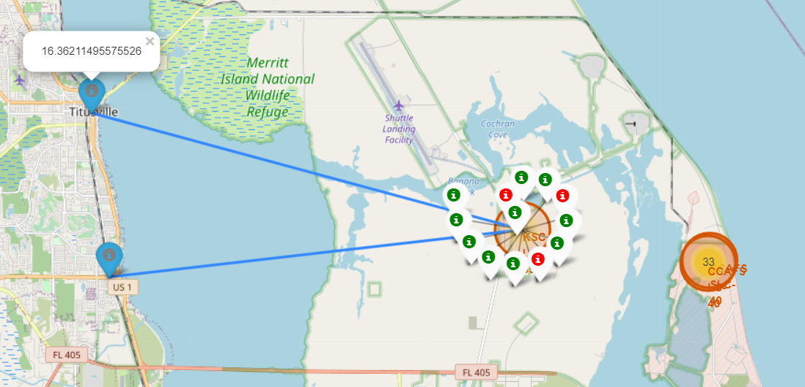
Map zoomed to east launch site
This is the zoomed in map showing lauch sites with green as successful and red as unsuccessful outcomes

Slide 38


Slide 39
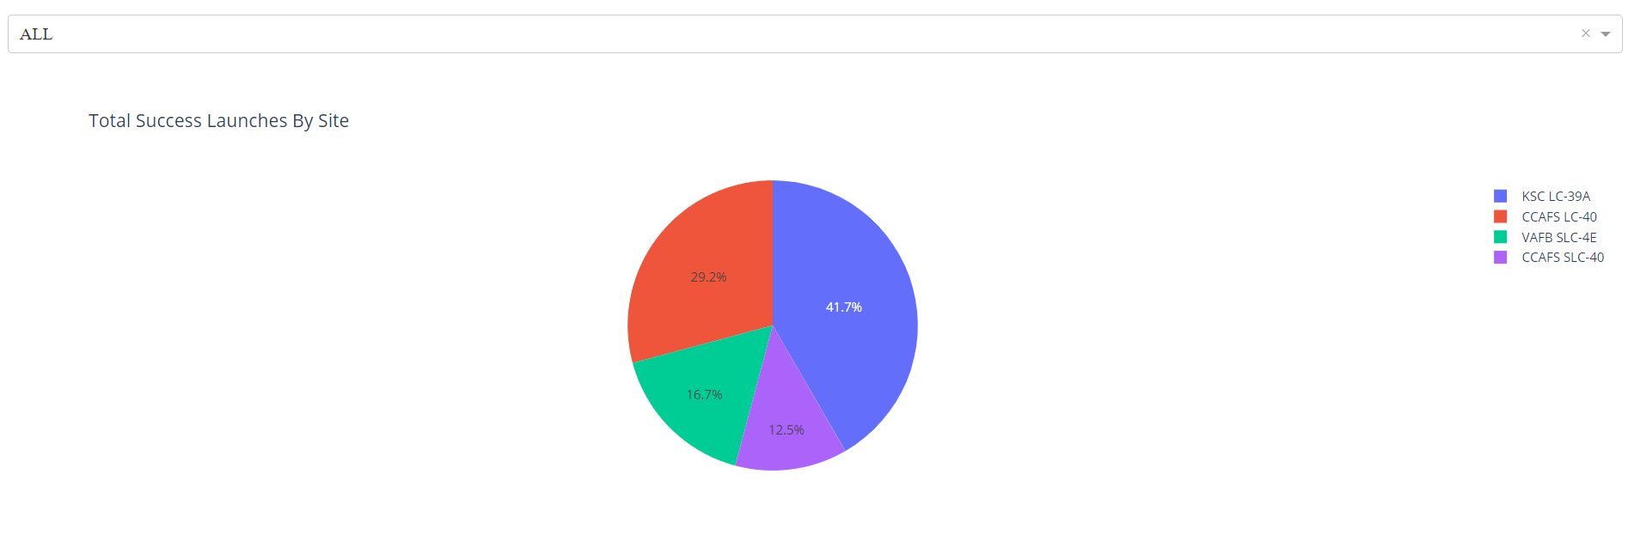
First graph in dashboard
Pie chart showing successful launches distribution with lauch site
Show the screenshot of launch success count for all sites, in a piechart
Explain the important elements and findings on the screenshot

Slide 40
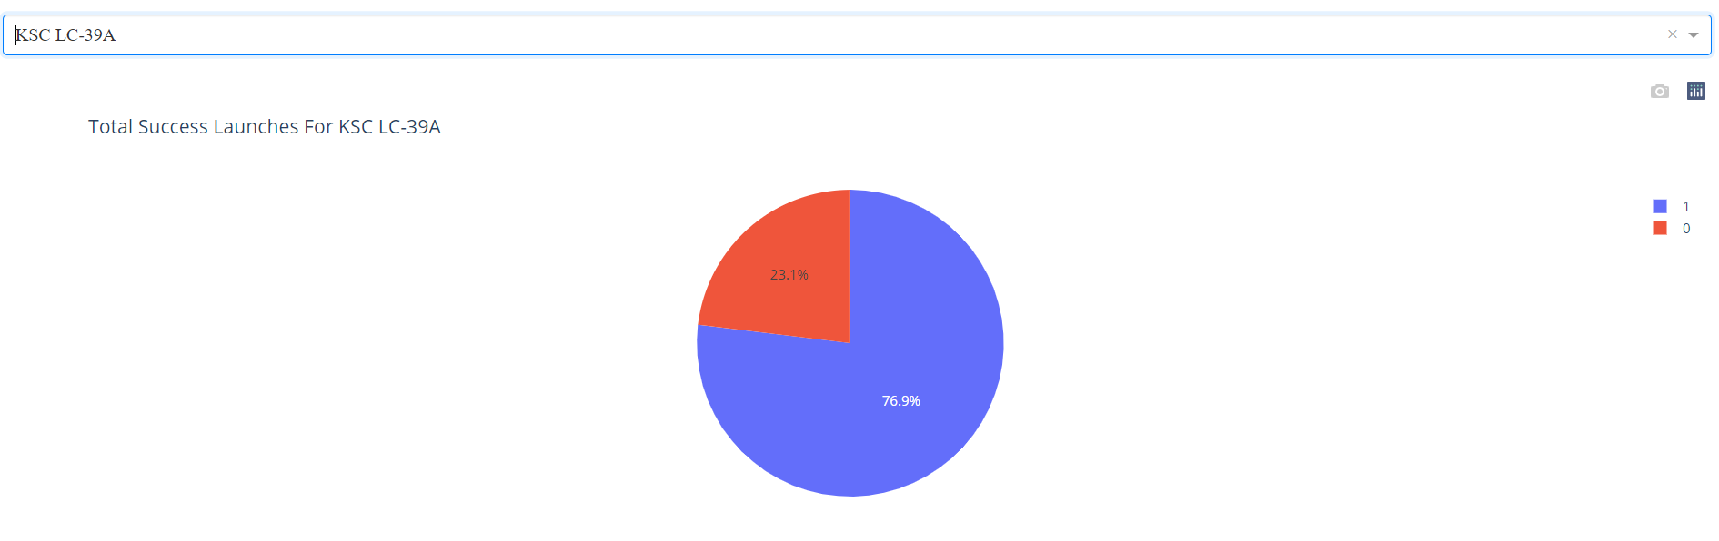
Pie chart KSC LC-39A
Another screenshot showing KSC LC-39a success rate

Slide 41
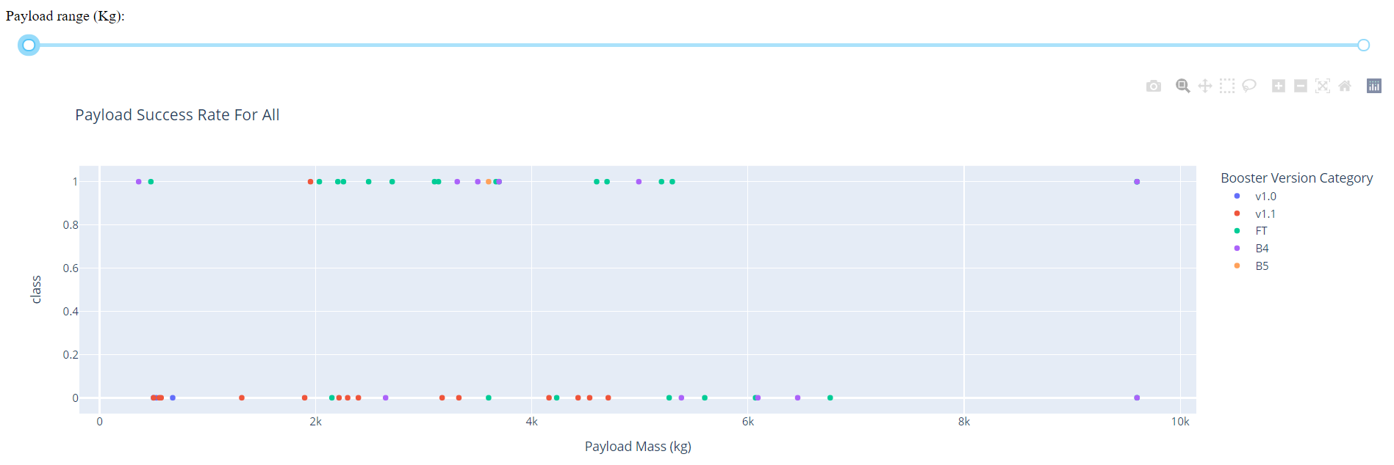
Payload vs class and outcome scatter plot
Payload vs success scatter plot.

Slide 42


Slide 43
Classification Accuracy

Slide 44
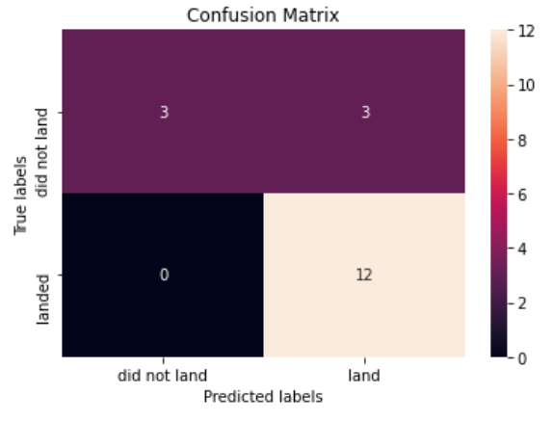
Confusion Matrix
Confusion matrix showing true positive, false positive, true negative and false negative in numbers

Slide 45
Conclusions
With predictive modelling technique, we predicted success rate of SpaceX launch outcome with 83% accuracy.
The insights obtained were
1. lower payload increased the success rate. However, payload is also linked to profitability. We have to come up with a optimal payload for acceptable success rate (assuming that rest of the parameters are constant). Another way is to retest the hypothesis with new technology and invasion
2. effect of orbits on success rate
3. launch site related features. Are there any room for improvement?

Slide 46
Appendix
All the source code and notebooks are in my github repository. I ran these notebooks in IBM Watson and/or google colab.
Github repository:
https://github.com/gvsanthu10/IBM_datascience

Slide 47
Future path
Try to deploy the dashboard in heroku website
The model should be trained with new data. If there significant drift or shift in the prediction, analyze the new parameters regarding change in the data
Continuous monitoring of the model workflow (website) and its performance (feedback)

Slide 48


